Slide 1

T2am_BPReader
The Best Application to use Airticket

Slide 2
Contents
What is BPReader?
Team Introduction
Developed Features
Code Structure
Using Library & License
Features to Develop

Slide 3



What is BPReader?
1. What is T2am?
2. Team member
Kyujin “The Carrier” Cho(Main Programmer / Designer)
Jaehyun “The TCG Gamer” Ahn(Designer)
Hanhyeok “The Idiotest” Hwang(Project Maintainer)
We Have Good Teamwork, Creative Thinking!
Like… Three Idiots!

Slide 4
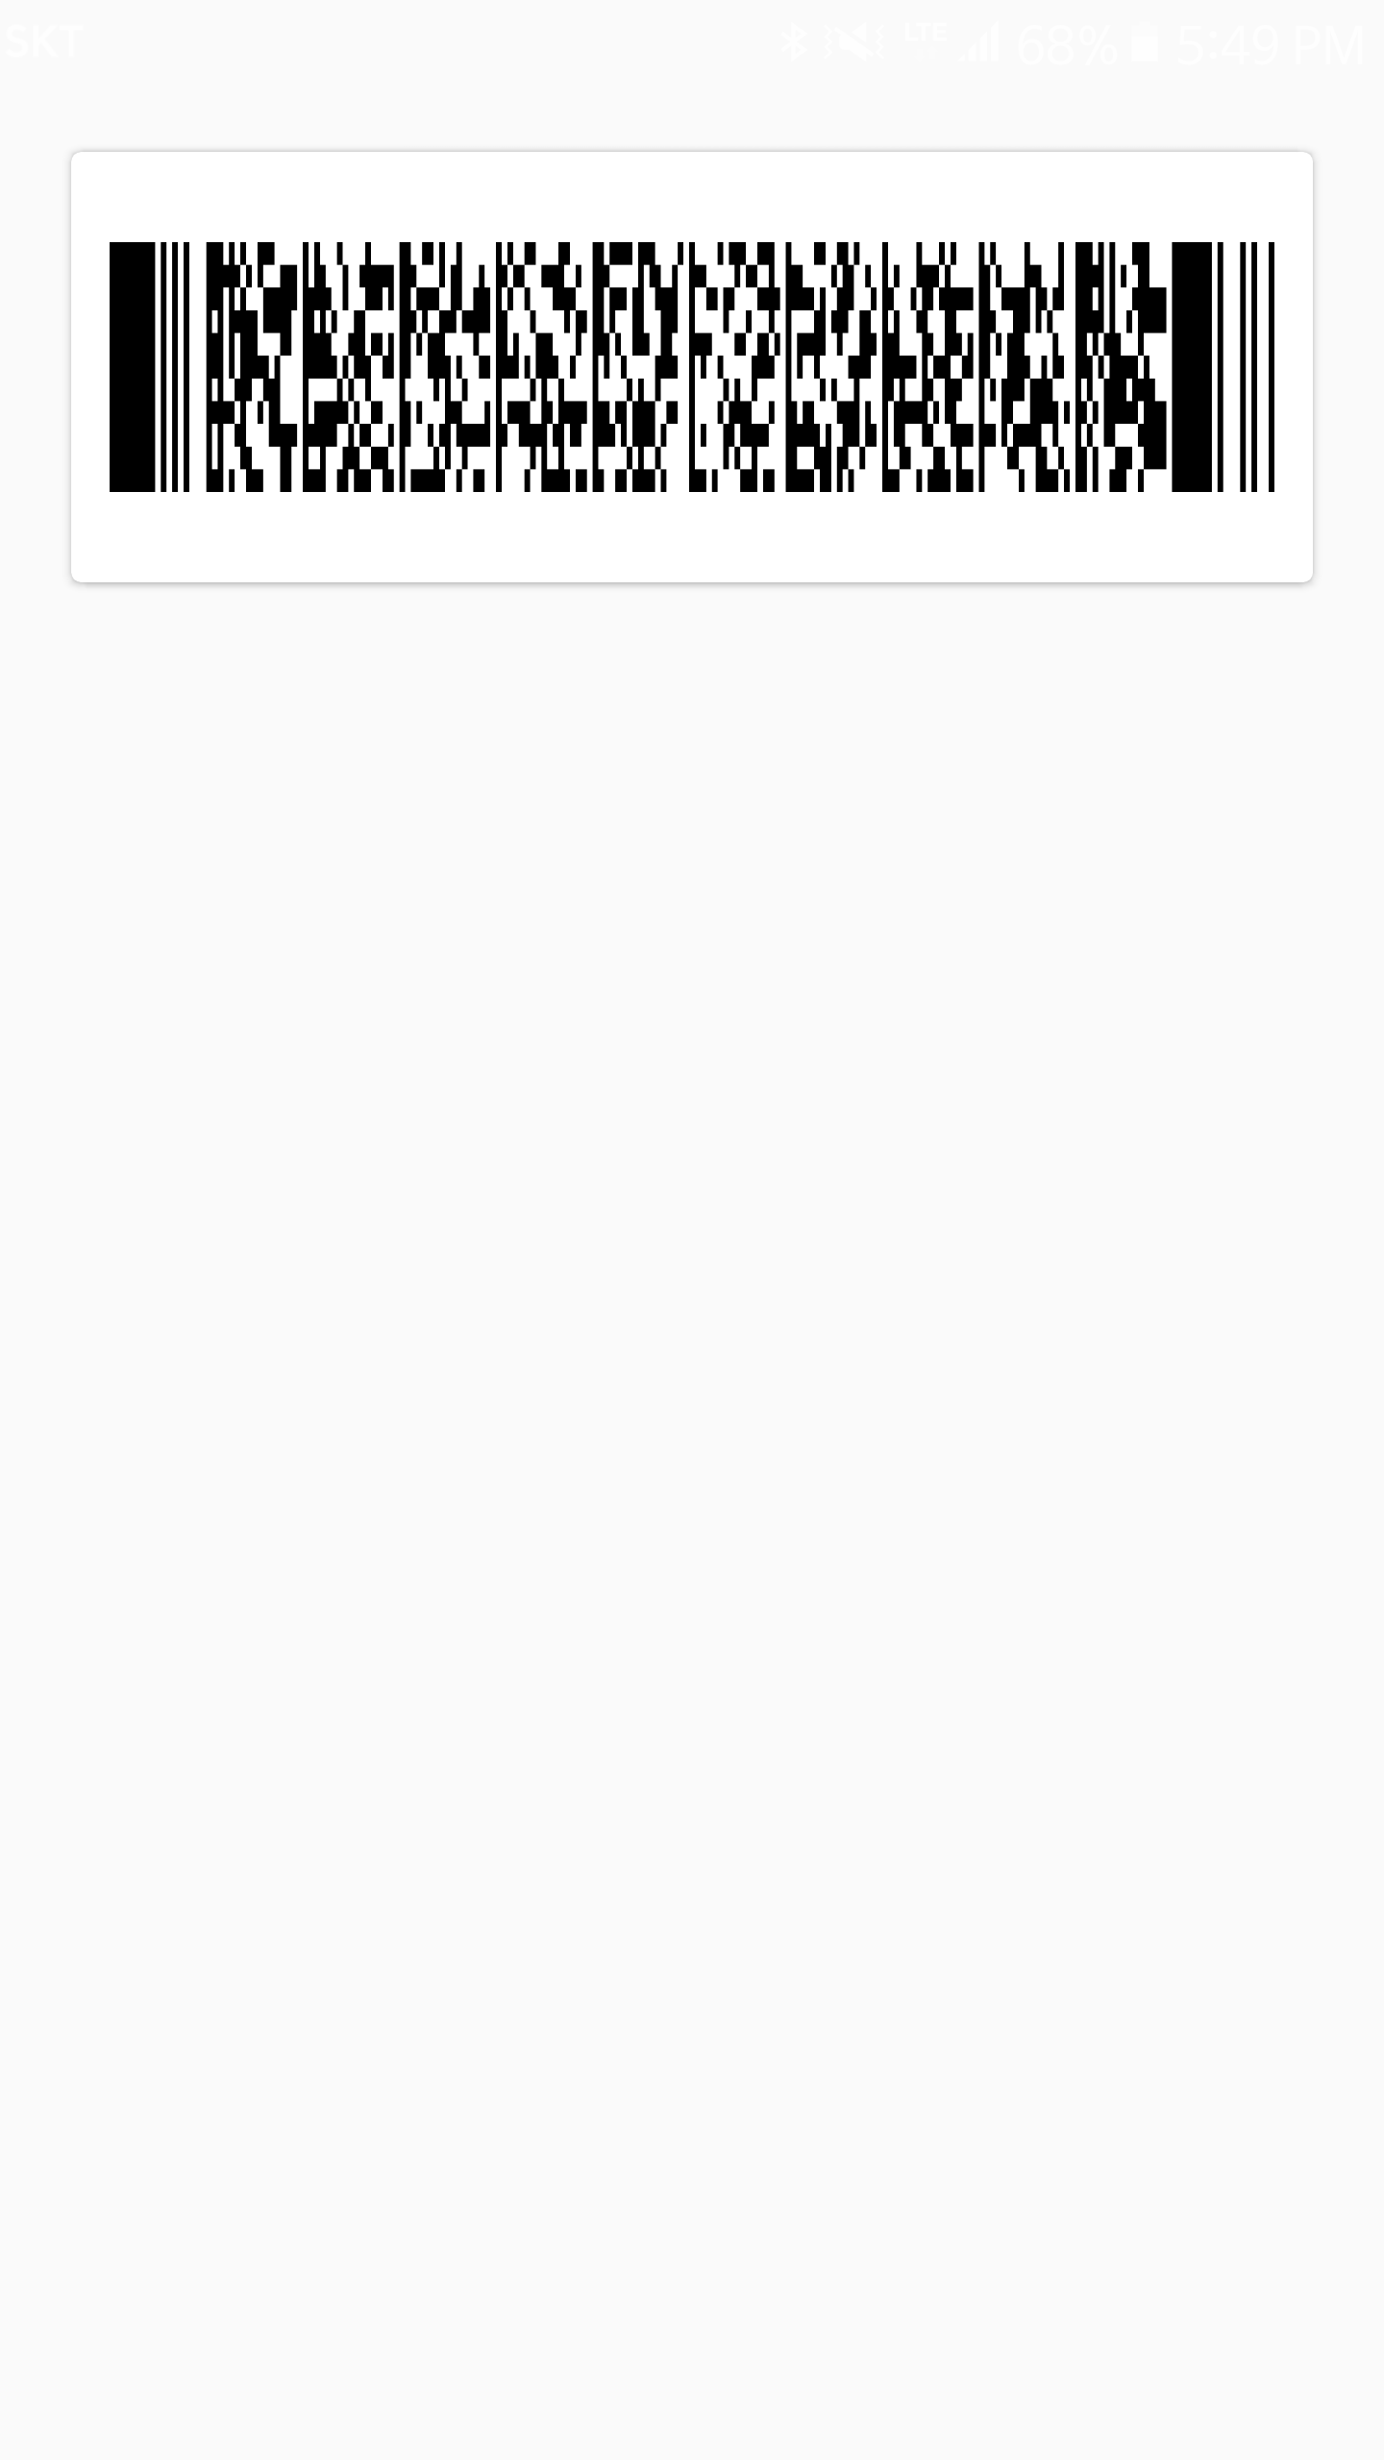
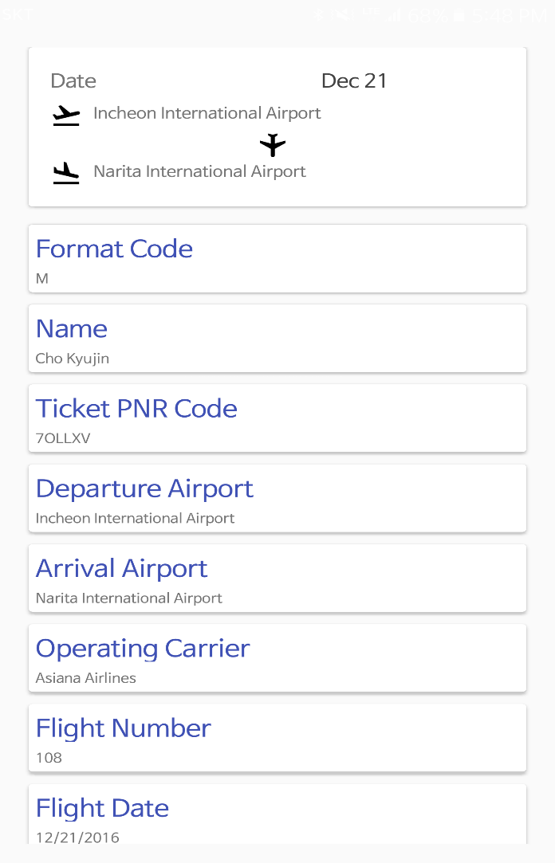
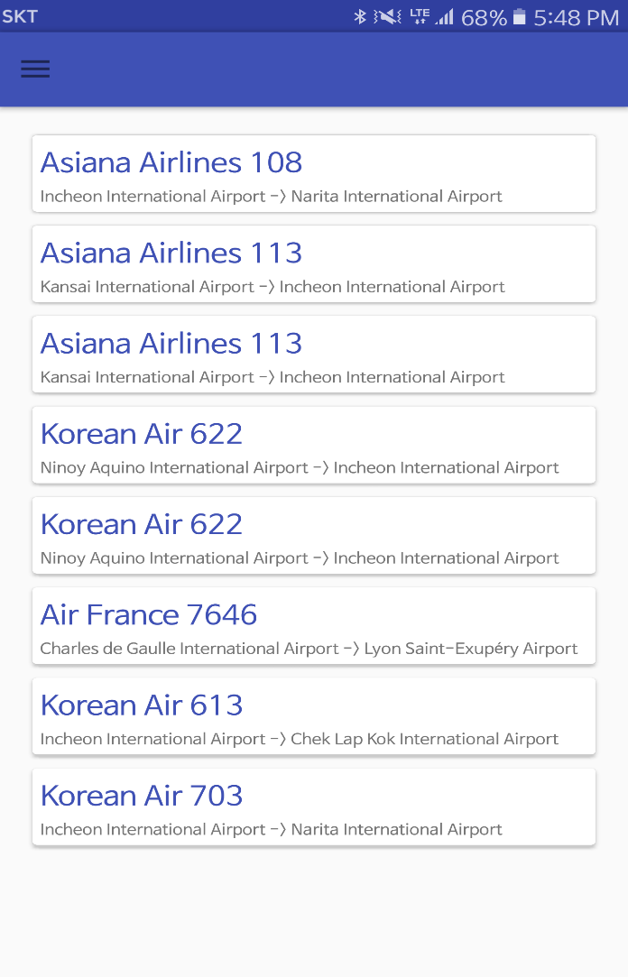
Team Introduction

Slide 5
Developed Features
1. Read Barcode
1 - Read Airticket Barcode From photo, etc…
2 - Parse Features of Barcode
3 - Push Parsedata to Print Scene
4 - You can also make the parsed data(In text) into barcodes.

Slide 6
Developed Features
2. Print BarcodeData
1 - Read Parsedata from Barcode Reading Scene
2 – Print Parsedata to the specified output Format
3 - Push Data to Storage

Slide 7
Developed Features
3. Data Storage
1 - Save Data From BarcodeData
2 – When you press each of the stored items, the output Scene appears.
3 – Can Delete Data in Storage!

Slide 8
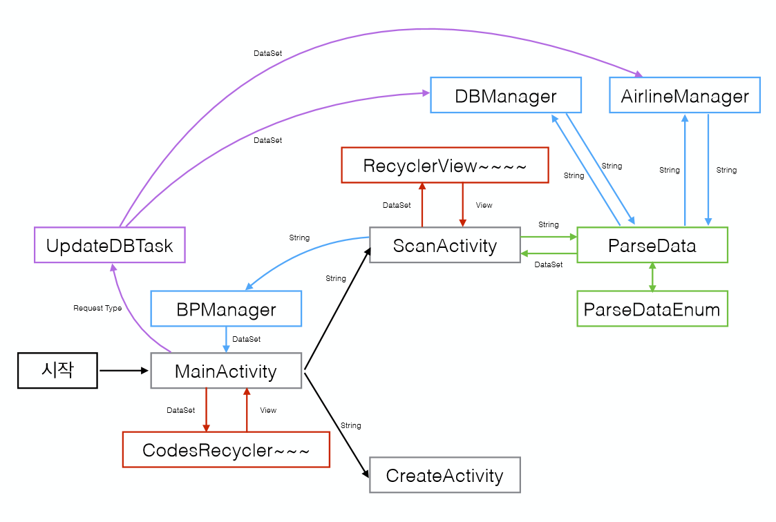
Code Structure

Slide 9


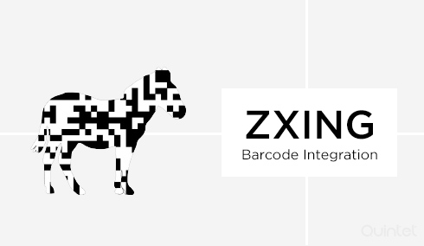
Using Library & License
License
Connects to internet and downloads newest Airline / Airport DB File
Scans PDF417 type barcode by camera

Slide 10
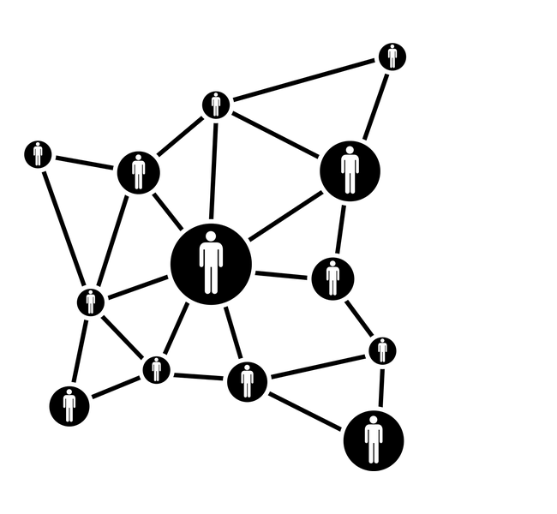

Features to Develop
1. Alarm System
2. Network matching System

Slide 11
T2am_BPReader
THANK YOU FOR YOUR ATTENTION!

